Slide 1


Slide 2

Organization – Bharat Electronics Limited , Bengaluru
DOMAIN BUCKET – Software Web App development
Category – Software Problem Number - MU455
Team Leader - Akansha Jain AISCHE Code – C-25158
Problem Statement – A complete software web application which provide standard solution handle multiple code-mixed Indian languages English, Hindi, Kannada ,Bengali, Urdu etc and perform context aware Sentiment Analysis give results such as “Positive”, “Negative“ and “Neutral”.

Slide 3
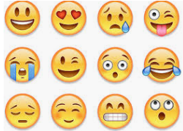
Problem Analysis
2. Identifying Need of Maintenance
3. Homophonic Word
1. Analysis on Different languages
There are several word like Rose -> flower and Rose -> Past tense of Rise which have same spelling and Pronunciation but different meaning.
Eg- he gave me rose and he rose from there have a different meaning
There are many different language are available globally that are used for comments by users.
Different languages used for commenting or review like languages like English, Hindi, Kannada ,Bengali, Urdu etc in India makes data handling difficult.
There is increase in review and comments by users day by day, as users use slangs and words which are not originally present in language.
4.Noise Detection
5. Detecting Unicode graphic Symbol
6. Dataset without Sentiment
It include emoji’s like ironic, sentimental sad in comment or review etc.
Sometimes in dataset we have to deal with stop words, unwanted numbers and other special symbols which is of no use .
Eg- @###888**
In some dataset, there is no sentiments available. So, for that dataset it has difficulty to predict sentiments of comments from dataset.
Eg when sentiment score not present in data.

Slide 4
Solutions to the problem
1. Analysis on Different languages
4. Identifying Need of Maintenance
6. User Interface
In this approach we train the classifier on English reviews and for testing, we translate the Hindi reviews or any other mixed language into English using Googletrans and then we classify the Sentiment of review and also we have separately worked on hinglish data by making stopwords dictionary for it.
.
There is increase in review and comments by users day by day, as users use slangs and words which are not originally present in language. To maintain such large dataset we will use tf-idf or CountVectorizer method to transform text into meaningful representation of numbers..
We have design a good user interface so that a user can have a good experience and can use on his own.
7. Graphical Analysis and emojis handling
2. Challenges in finding abusive words
5. Dataset without Sentiment
We will present a detailed analysis by scatter plots, bar graphs, pi-charts etc. using python libraries.
We will be using machine learning based methods to detect hate speech on user comments from three sentiments Positive, Negative, Neutral.
In some dataset, there is no sentiments available. So, there is difficulty to find sentiments of comments from dataset. For that, our model first find the Sentiment Score from our design model and then further dataset is processed.
.
For analyzing emojis we have imported UNICODE_EMOJI library and also made a folder of all emojis with there meaning

Slide 5
Architecture of Model Prepared
Dataset with Sentiment
Dataset without Sentiment
Remove stopwords & apply WordNetLemmatizer on Comments
Remove stopwords & apply WordNetLemmatizer on Comments
apply CountVectorizer on Comments
apply sentiwordnet & SentimentIntensityAnalyzer on Comments to generate score
Apply train_test_split
Apply Classification algorithm of best accuracy
Based on Score categorize into Sentiment
Predict the Sentiment through Trained Classification model
Generate Dataset with Sentiment

Slide 6
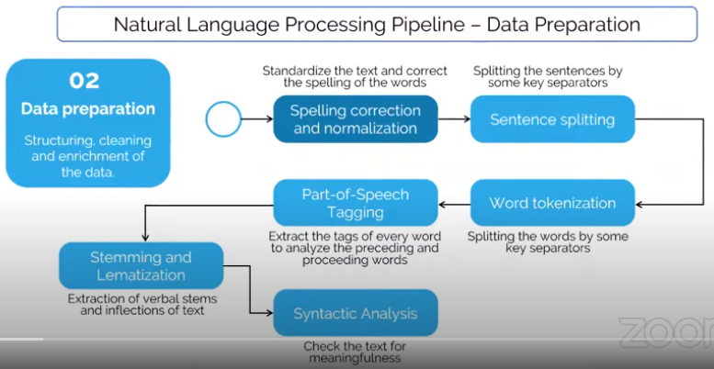
Working of Application

Slide 7
Algorithms and their performance
Algorithms | Accuracy (based on 25000 dataset)
Decision Tree Classifier | 76 %
Random Forest Classifier | 81 %
SVC | 71 %
K Neighbors Classifier | 69 %
Gaussian N B | 45 %
ExtraTreesClassifier | 82 %
GradientBoostingClassifier | 77 %
LogisticRegression | 84 %
BernoulliNB | 69 %
Artifical Neural Network | 60%

Slide 8
Technology Stack
Machine Leaning : As the machine learning are predicting the consequences of Positive, Negative or Neutral on the basis of the previously learnt data.
Web Development – HTML, CSS, JavaScript, Flask, AJAX.
Benefits to Society
Business: In marketing field companies use it to develop their strategies, to understand customers’ feelings towards products or brand, how people respond to their campaigns or product launches and why consumers don’t buy some products.
Politics: In the political field, it is used to keep track of political view, to detect consistency and inconsistency between statements and actions at the government level. It can be used to predict election results as well!.
Public Actions: Sentiment analysis also is used to monitor and analyze social phenomena, for the spotting of potentially dangerous situations and determining the general mood of the blogosphere.

Slide 9
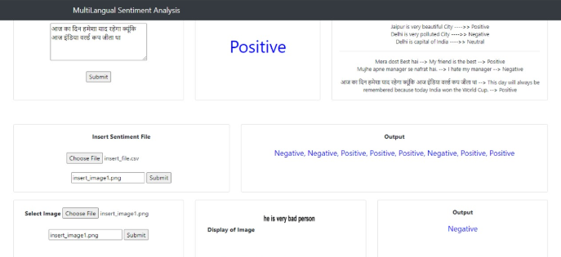
UI DESIGN

Slide 10
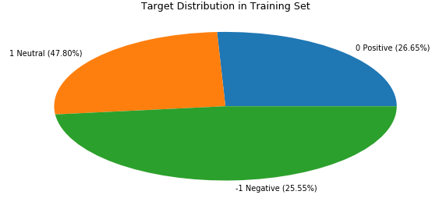
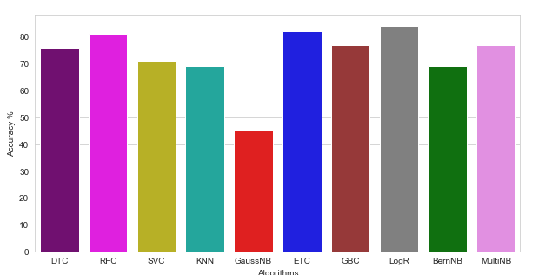
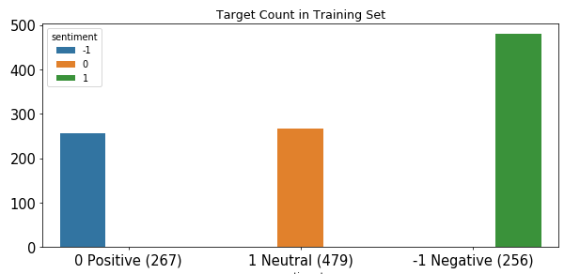
SOME VISUALISATIONS FROM SCRIPT

Slide 11


